Slide 1
Data that are not Continuous
Matthew W Wheeler

Slide 2
Introduction:
All statistical tests are based upon the underlying assumed variance.
To this point, all we have really considered are normal models, which have constant variance.
For large, or really large, samples this is a pretty good approximation, but it doesn’t make sense for certain types of data.

Slide 3
Different Types of Data
There are many situations where what we measure is not a continuous variable:
We could measure the number insurance claims of an individual (count)
We can measure if an individual visits a website each day for a week (proportion/probability)
We can measure if a person ends up in prison again after an intervention (proportion/probability)
For many situations, we can approximate continuous data, but there are other situations where it doesn’t make any sense.

Slide 4
The biggest issue is that when we have non-normal our typical data assumptions do not apply:
For count data, the Poisson distribution is usually used to model such data. For this distribution the variance = mean (or rate).
For success/failure data, the Binomial distribution is used frequently. For this distribution the variance is at a maximum when the probability of response p = 0.5 as variance = np(1-p), where n is the number of trials.
We are going to use two popular models for such data:
Logistic – Binomial
Log-Linear – Poisson

Slide 5
Types of Data
Poisson
Binomial
Experiments results in count y
The rate of occurrence is λ
Sometimes we have this observed over some unit time or area t
We expect λ/t counts per unit.
Variance Y/t = λ/t
We model log(λ/t) =β₀ + β₁x
Experiment with n trials and y successes.
Success occurs with probability p
We expect np successes.
The variance of y is np(1-p)
We model
log [p/(1-p)] = β₀ + β₁x

Slide 6
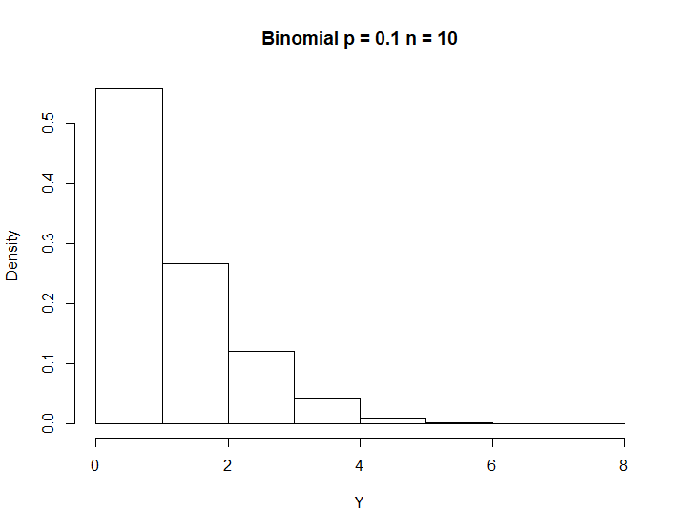
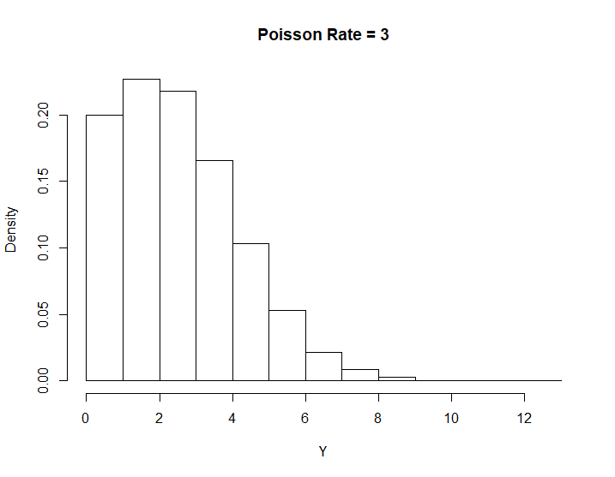
How bad is non-constant variance?
Binomial
Poisson

Slide 7
Modeling is straightforward using the SAS proc genmod.
For us, the majority of modeling statements will be the same, which makes our life much easier.
The reason why we use these methods over glm is because our analyses will be more accurate because we are not relying on some normal approximation.
When I have huge sample sizes. Normality is a safe assumption.

Slide 8
Example 1
An insurer is interested in looking at the rate of claims by the age of the person insured and the size of the car. A random sample of the companies policies are taken and we are interested in seeing if the claim rate is different between the car size and age.
Response: Number of Claims
Offset: Number of Policies
Variables: Age/Size

Slide 9
Data:
/*insurance data*/
data insure;
input n claims car$ age;
ln = log(n);
datalines;
500 42 small 1
1200 37 medium 1
100 1 large 1
400 101 small 2
500 73 medium 2
300 14 large 2
;
run;

Slide 10
/*initial cut at the data*/
proc genmod data=insure;
class car age/param=glm; *param=glm codes it like glm
*so we can think of it in the same way;
model claims = car age/dist = poisson
/*our data is count data we use
the poisson distribution*/
link = log TYPE3
/*TYPE3 IS LIKE TYPE III SUMS OF SQUARES*/
offset = ln; /*THIS IS OVER A NUMBER OF CUSTOMERS*/
contrast 'Large vs. small' car 1 0 -1;
run;
quit;

Slide 11
Criteria For Assessing Goodness Of Fit
Criterion | DF | Value | Value/DF
Deviance | 2 | 2.8207 | 1.4103
Scaled Deviance | 2 | 2.8207 | 1.4103
Pearson Chi-Square | 2 | 2.8416 | 1.4208
Scaled Pearson X2 | 2 | 2.8416 | 1.4208
Log Likelihood |  | 837.4533
Full Log Likelihood |  | -16.4638
AIC (smaller is better) |  | 40.9276
AICC (smaller is better) |  | 80.9276
BIC (smaller is better) |  | 40.0946
This should be close to 1 if it is not, we need to adjust so our tests
statistics are more correct. The value 1.4 is good enough.

Slide 12
Contrast Results
Contrast | DF | Chi-Square | Pr > ChiSq | Type
Large vs. small | 1 | 65.37 | <.0001 | LR
LR Statistics For Type 3 Analysis
Source | DF | Chi-Square | Pr > ChiSq
car | 2 | 72.82 | <.0001
age | 1 | 104.64 | <.0001

Slide 13
Tests are called Likelihood Ratio Tests
All tests are Likelihood ratio tests:
They are similar to our standard F-test, but are used in cases where we do not have normality.
They are essentially the fit of the model with and without the parameters. The -2 Log of this ratio is distributed approximately chi-squared with degrees of freedom the difference in parameters constrained.

Slide 14
There are two parameters constrained by car.
LR Statistics For Type 3 Analysis
Source | DF | Chi-Square | Pr > ChiSq
car | 2 | 72.82 | <.0001
age | 1 | 104.64 | <.0001
There is one parameter constrained by age

Slide 15
Though there are a lot of difference theoretically between normal glm based ANOVA and poisson genmod ANALYSIS OF DEVIANCE, from a SAS perspective (or R) there are not that many differences when you are analyzing the data.
Further, you design the study in THE EXACT SAME MANNER as anything we have done so far. All you have to worry about is the analysis.

Slide 16
Analysis 2
An experiment is conducted to look at the probability an ingot is not ready for rolling after a several treatments. We are interested in finding the optimal conditions for rolling.

Slide 17
/*example 2 ingots data*/
data ingots;
input Heat Soak r n @@;
datalines;
7 1.0 0 10 14 1.0 0 31 27 1.0 1 56 51 1.0 3 13
7 1.7 0 17 14 1.7 0 43 27 1.7 4 44 51 1.7 0 1
7 2.2 0 7 14 2.2 2 33 27 2.2 0 21 51 2.2 0 1
7 2.8 0 12 14 2.8 0 31 27 2.8 1 22 51 4.0 0 1
7 4.0 0 9 14 4.0 0 19 27 4.0 1 16
;

Slide 18
/*binomial distribution
logit analysis*/
proc genmod data=ingots;
class heat soak;
/*r observations total of n ingots*/
model r/n = heat soak/ dist=bin /*binomial distribution*/
TYPE3 /*type 3 analysis of deviance*/
link=logit; /*logit link*/;
contrast 'Background vs 27 heat' heat 0 0 1 -1;
contrast 'Backtroung vs 14 heat' heat 0 1 0 -1;
/*These are not the Wald tests above,
they will not have the same P-value*/
run;

Slide 19
The probability of not being rolled decreases as the heat ‘goes down’
Also the effect of 7 is what it is because there were no ‘failures’ for all
7 s’s
Analysis Of Maximum Likelihood Parameter Estimates
Parameter |  | DF | Estimate | Standard Error | Wald 95% Confidence Limits |  | Wald Chi-Square | Pr > ChiSq
Intercept |  | 1 | -1.3236 | 1.2450 | -3.7637 | 1.1164 | 1.13 | 0.2877
Heat | 7 | 1 | -26.4235 | 127806.9 | -250523 | 250470.4 | 0.00 | 0.9998
Heat | 14 | 1 | -3.2610 | 1.0737 | -5.3653 | -1.1566 | 9.22 | 0.0024
Heat | 27 | 1 | -1.9254 | 0.8507 | -3.5927 | -0.2581 | 5.12 | 0.0236
Heat | 51 | 0 | 0.0000 | 0.0000 | 0.0000 | 0.0000 | . | .
Soak | 1 | 1 | -0.2829 | 1.1962 | -2.6273 | 2.0616 | 0.06 | 0.8131
Soak | 1.7 | 1 | 0.5951 | 1.1639 | -1.6860 | 2.8763 | 0.26 | 0.6091
Soak | 2.2 | 1 | 0.4395 | 1.2739 | -2.0573 | 2.9363 | 0.12 | 0.7301
Soak | 2.8 | 1 | -0.1305 | 1.4574 | -2.9870 | 2.7261 | 0.01 | 0.9287
Soak | 4 | 0 | 0.0000 | 0.0000 | 0.0000 | 0.0000 | . | .
Scale |  | 0 | 1.0000 | 0.0000 | 1.0000 | 1.0000

Slide 20
LR Statistics For Type 3 Analysis
Source | DF | Chi-Square | Pr > ChiSq
Heat | 3 | 13.08 | 0.0045
Soak | 4 | 1.41 | 0.8422
Contrast Results
Contrast | DF | Chi-Square | Pr > ChiSq | Type
Background vs 27 heat | 1 | 4.54 | 0.0332 | LR
Backtroung vs 14 heat | 1 | 9.05 | 0.0026 | LR

Slide 21
What about a linear term?
/*Look at as a linear term*/
proc genmod data=ingots;
*class heat soak;
/*r observations total of n ingots*/
model r/n = heat / dist=bin /*binomial distribution*/
TYPE3 /*type 3 analysis of deviance*/
link=logit; /*logit link*/;
run;

Slide 22
Analysis Of Maximum Likelihood Parameter Estimates
Parameter | DF | Estimate | Standard Error | Wald 95% Confidence Limits |  | Wald Chi-Square | Pr > ChiSq
Intercept | 1 | -5.4152 | 0.7275 | -6.8411 | -3.9892 | 55.40 | <.0001
Heat | 1 | 0.0807 | 0.0224 | 0.0369 | 0.1245 | 13.03 | 0.0003
Scale | 0 | 1.0000 | 0.0000 | 1.0000 | 1.0000

Slide 23
Which one is better?
The models are not nested so we have to compare the
AIC: 32.109 vs 41.6018
For prediction I would pick the linear logistic model, for the comparisons do the analysis of deviance for the first model.

